Slide 1
Unit 4
Lecture 5

Slide 2
Morphological image processing techniques
Morphology: In biology, describes about the structure and shape of organisms
Image processing operations that take into consideration the structure and shape of objects is called morphological operations
Applications:
Preprocessing: filtering, shape simplification
Separation of the object region from the background image
Noise filtering
Simplify complex structure to simple sub structures
Segmentation using object shape
Object quantification:
area, perimeter of the object region
Boundary of object region

Slide 3
Enhancing object structure
Thinning, thickening, convex hull, skeletonization, object marking etc.
Image as a Set of points
Basic assumption: image can be represented as a set of points
Consider the binary image given
Shaded points represent the object pixel and others are
the background pixel
Coordinate system representation
X={(0,2)(1,1)(1,3)(2,1)(2,2)(2,3)(3,1)(3,2)(3,3)(4,1)(4,2)(4,3)}
are members of the set X which represents the object pixels
Background pixel= X complement
Morphological operations are now set operations on these set of points

Slide 4
Review of set operations
If we consider a point set A in 2D
a belongs to A, if a is represented as a=(a1,a2)
b do not belong to A
Subset:
if A and B are two point sets in 2D space then
A is a subset of B if every element of A belongs to B
Reverse is not true
Union and intersection: AUB and A intersection B
Complement of A={b|b do not belong to A}
Set Difference:{w|w belongs to A and w do not belong to B}
Remove the elements in A which are not in B

Slide 5
Reflection of B
B^ ={w|w=-b for b belonging to B}
All points in B which are negated
Translation
Translate by a vector z={z1,z2}
Az = {c|c=a+z for a belonging to A}
Translation of A by z: set of all points c such that a+z for a belonging to A

Slide 6
Morphological transformations (ᴪ)
Gives a relation of the image X with another small point set B called the structuring element
Dilation
Erosion
Closing
Opening
B
X

Slide 7
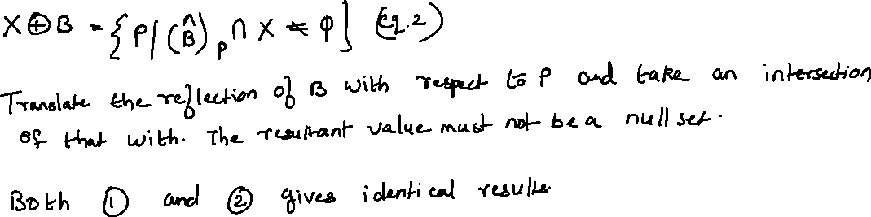
Dilation
Defined in terms of set addition or vector addition between image X and the Structuring Element B
XꚚB = set of points P in 2D space Z such that P=x+b where x belongs to X and b belongs to B
XꚚB= {PϵZ|P=x+b } (eq.1)

Slide 8
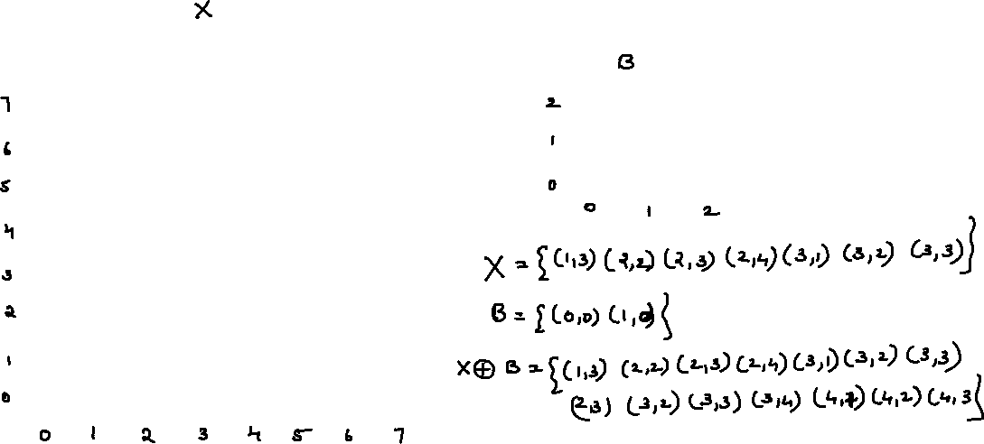
0 | 0 | 0 | 0 | 0 | 0 | 0 | 0
0 | 0 | 0 | 0 | 0 | 0 | 0 | 0
0 | 0 | 0 | 0 | 0 | 0 | 0 | 0
0 | 0 | 1 | 0 | 0 | 0 | 0 | 0
0 | 1 | 1 | 1 | 0 | 0 | 0 | 0
0 | 0 | 1 | 1 | 0 | 0 | 0 | 0
0 | 0 | 0 | 1 | 0 | 0 | 0 | 0
0 | 0 | 0 | 0 | 0 | 0 | 0 | 0
0 | 0 | 0
0 | 0 | 0
1 | 1 | 0

Slide 9
0 | 0 | 0 | 0 | 0 | 0 | 0 | 0
0 | 0 | 0 | 0 | 0 | 0 | 0 | 0
0 | 0 | 0 | 0 | 0 | 0 | 0 | 0
0 | 0 | 1 | 1 | 0 | 0 | 0 | 0
0 | 1 | 1 | 1 | 1 | 0 | 0 | 0
0 | 0 | 1 | 1 | 1 | 0 | 0 | 0
0 | 0 | 0 | 1 | 1 | 0 | 0 | 0
0 | 0 | 0 | 0 | 0 | 0 | 0 | 0
0 | 0 | 0
0 | 0 | 0
1 | 1 | 0

Slide 10
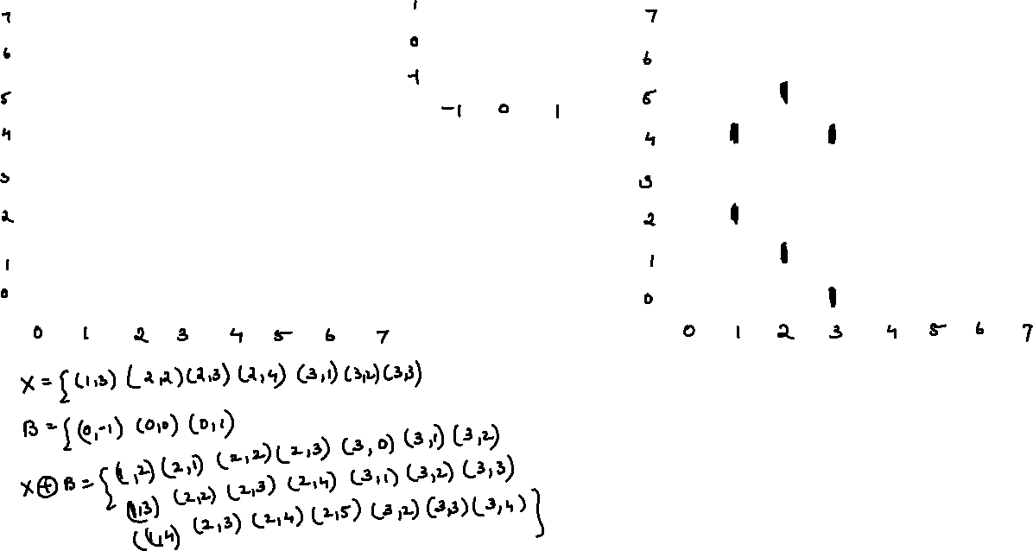
0 | 0 | 0 | 0 | 0 | 0 | 0 | 0
0 | 0 | 0 | 0 | 0 | 0 | 0 | 0
0 | 0 | 0 | 0 | 0 | 0 | 0 | 0
0 | 0 | 1 | 0 | 0 | 0 | 0 | 0
0 | 1 | 1 | 1 | 0 | 0 | 0 | 0
0 | 0 | 1 | 1 | 0 | 0 | 0 | 0
0 | 0 | 0 | 1 | 0 | 0 | 0 | 0
0 | 0 | 0 | 0 | 0 | 0 | 0 | 0
0 | 1 | 0
0 | 1 | 0
0 | 1 | 0
0 | 0 | 0 | 0 | 0 | 0 | 0 | 0
0 | 0 | 0 | 0 | 0 | 0 | 0 | 0
0 | 0 | 0 | 0 | 0 | 0 | 0 | 0
0 | 0 | 1 | 0 | 0 | 0 | 0 | 0
0 | 1 | 1 | 1 | 0 | 0 | 0 | 0
0 | 0 | 1 | 1 | 0 | 0 | 0 | 0
0 | 0 | 0 | 1 | 0 | 0 | 0 | 0
0 | 0 | 0 | 0 | 0 | 0 | 0 | 0

Slide 11
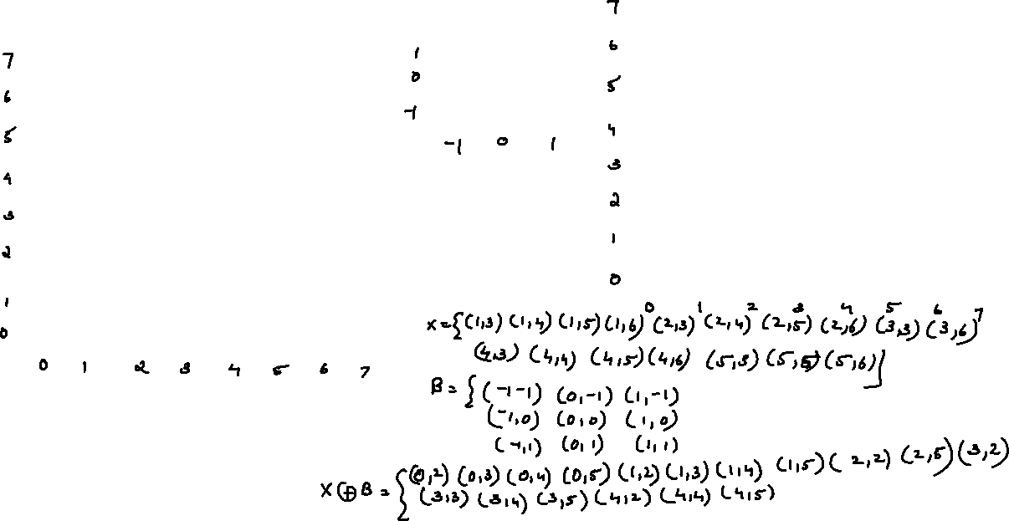
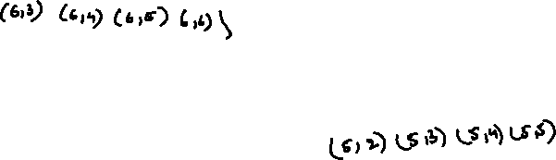
Application: Noise removal
1 | 1 | 1 | 1 | 1 | 1 | 1 | 1
1 | 1 | 1 | 1 | 1 | 1 | 1 | 1
1 | 1 | 1 | 1 | 1 | 1 | 1 | 1
1 | 1 | 1 | 1 | 1 | 1 | 1 | 1
1 | 1 | 1 | 1 | 1 | 1 | 1 | 1
1 | 1 | 1 | 1 | 1 | 1 | 1 | 1
0 | 0 | 0 | 0 | 0 | 0 | 0 | 0
0 | 0 | 0 | 0 | 0 | 0 | 0 | 0
0 | 0 | 0 | 0 | 0 | 0 | 0 | 0
0 | 1 | 1 | 1 | 1 | 1 | 1 | 0
0 | 1 | 1 | 0 | 1 | 1 | 1 | 0
0 | 1 | 1 | 0 | 1 | 0 | 1 | 0
0 | 1 | 1 | 1 | 1 | 1 | 1 | 0
0 | 0 | 0 | 0 | 0 | 0 | 0 | 0
0 | 0 | 0 | 0 | 0 | 0 | 0 | 0
0 | 0 | 0 | 0 | 0 | 0 | 0 | 0
1 | 1 | 1
1 | 1 | 1
1 | 1 | 1
The zero points within the object is due to noise
(5,2)(5,3)(5,4)(5,5)

Slide 12
Object boundary gets expanded and the noisy points becomes part of the image.
Can be used for edge detection
Take dilation of an image
Subtract that from the original image to get edges
Dilation is also known as grow operation as the edges of the object is getting expanded

Slide 13
Dilation example
Original image
Dilation with 3x3 SE
Dilation with 7x7 SE

Slide 14
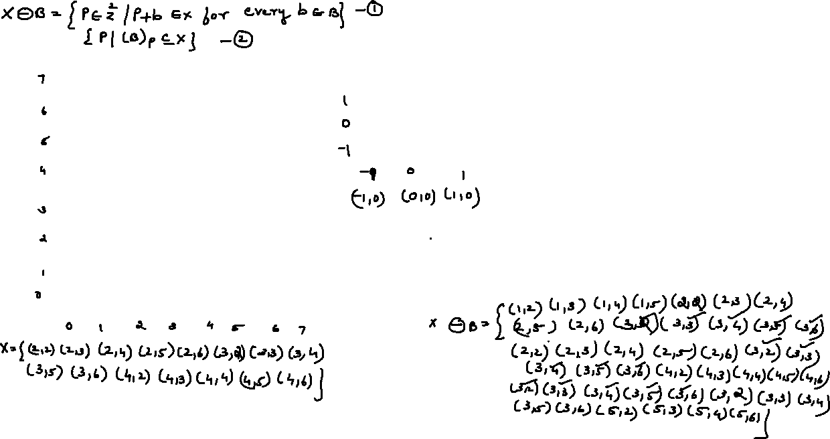
Erosion operation (shrink operation)
0 | 0 | 0 | 0 | 0 | 0 | 0 | 0
0 | 0 | 0 | 1 | 0 | 0 | 0 | 0
0 | 0 | 0 | 1 | 0 | 0 | 0 | 0
0 | 0 | 0 | 1 | 0 | 0 | 0 | 0
0 | 0 | 0 | 1 | 0 | 0 | 0 | 0
0 | 0 | 0 | 1 | 0 | 0 | 0 | 0
0 | 0 | 0 | 0 | 0 | 0 | 0 | 0
0 | 0 | 0 | 0 | 0 | 0 | 0 | 0
0 | 0 | 0 | 0 | 0 | 0 | 0 | 0
0 | 0 | 1 | 1 | 1 | 0 | 0 | 0
0 | 0 | 1 | 1 | 1 | 0 | 0 | 0
0 | 0 | 1 | 1 | 1 | 0 | 0 | 0
0 | 0 | 1 | 1 | 1 | 0 | 0 | 0
0 | 0 | 1 | 1 | 1 | 0 | 0 | 0
0 | 0 | 0 | 0 | 0 | 0 | 0 | 0
0 | 0 | 0 | 0 | 0 | 0 | 0 | 0
0 | 0 | 0
1 | 1 | 1
0 | 0 | 0

Slide 15
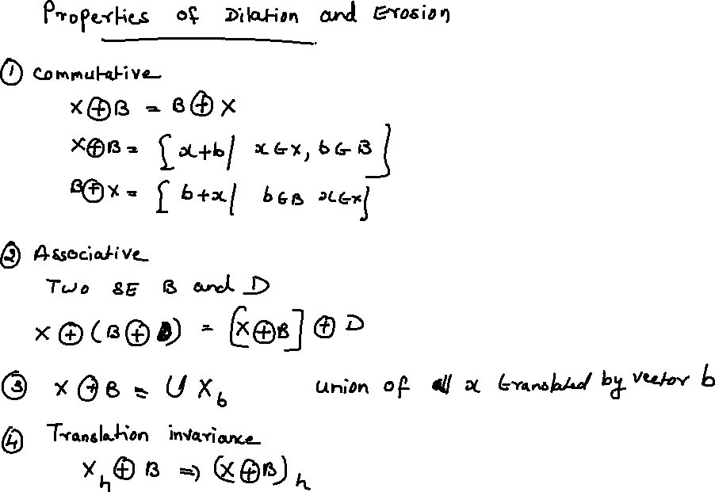

Slide 16
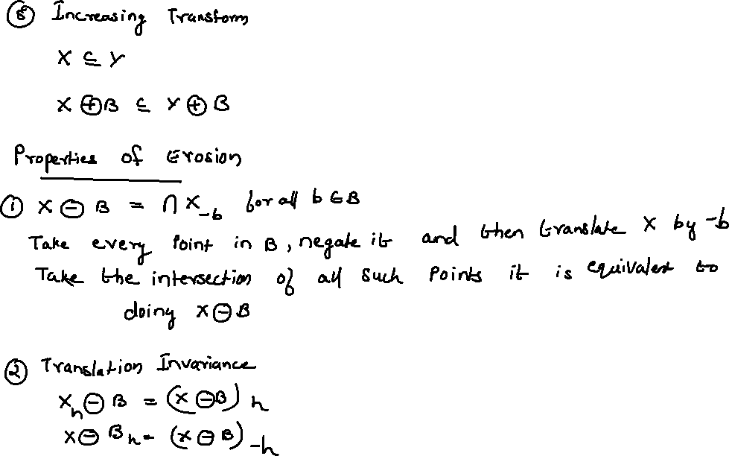

Slide 17
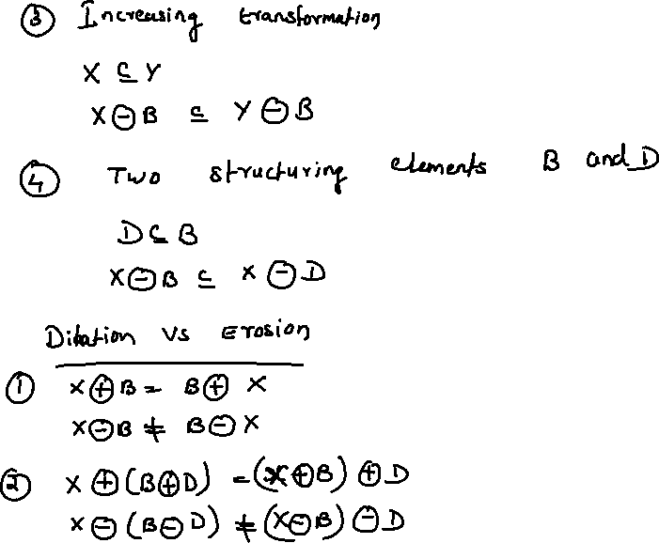

Slide 18
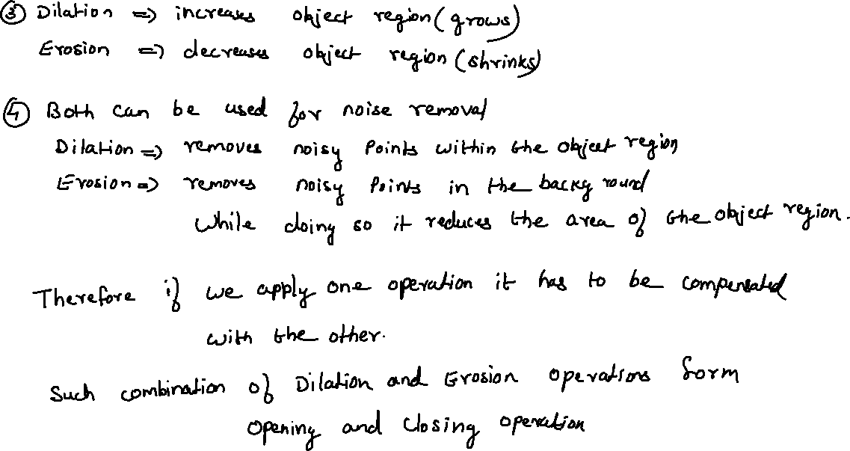

Slide 19
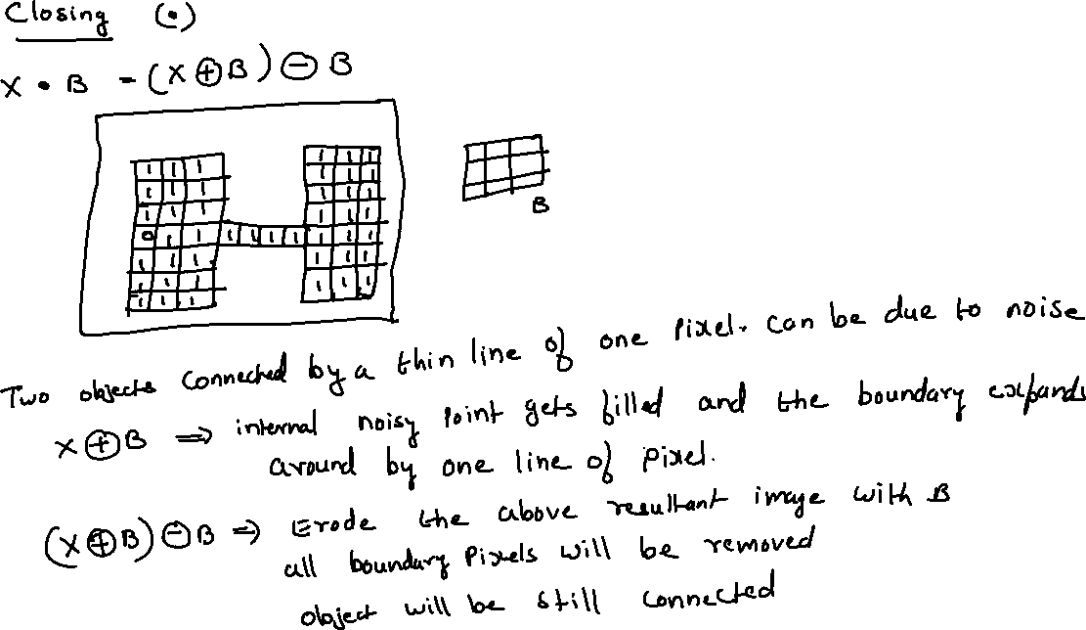

Slide 20
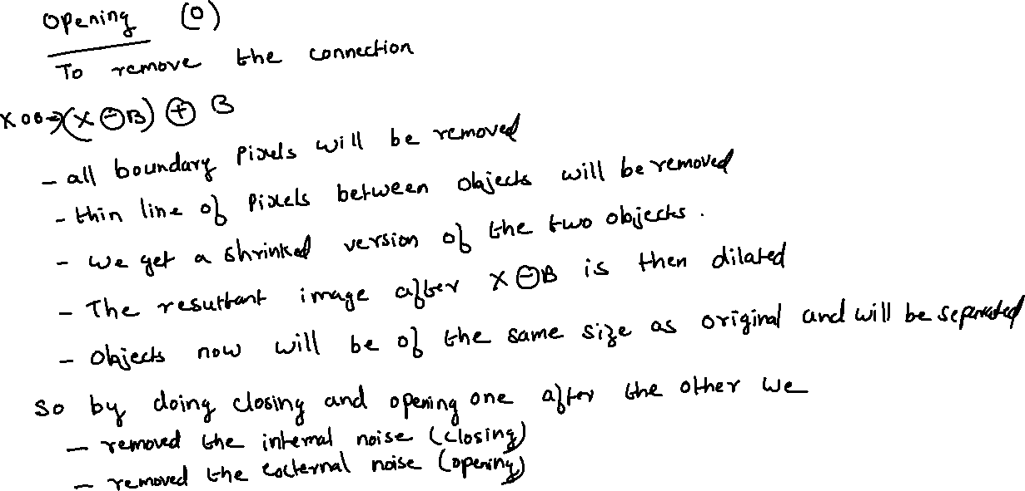
Opening

Slide 21
Open and Close
Removal of thin connections and protrusions
Fills holes

Slide 22
import cv2
import numpy as np
img = cv2.imread('j.png',0)
kernel = np.ones((5,5),np.uint8)
erosion = cv2.erode(img,kernel,iterations = 1)
dilation = cv2.dilate(img,kernel,iterations = 1)

Slide 23
Example of reflection and translation
If B = {(1,2),(2,2),(-1,0)
Reflection of set B is {(-1,-2),(-2,-2),(1,0)}
If X={(1,2),(3,2)}
Translation of X by point p say (1,0) is the set {(2,2)(4,2)}
Check whether the two equations 1 and 2 give the same result.
XꚚB= {PϵZ|P=x+b } (eq.1)
Add the coordinates of the structuring element to the object X find the resultant point, that point will be in the dilated set
If X={(3,2)} and B={(-1,0), (2,0)}
Dilated set P= {(2,2),(5,2)}

Slide 24
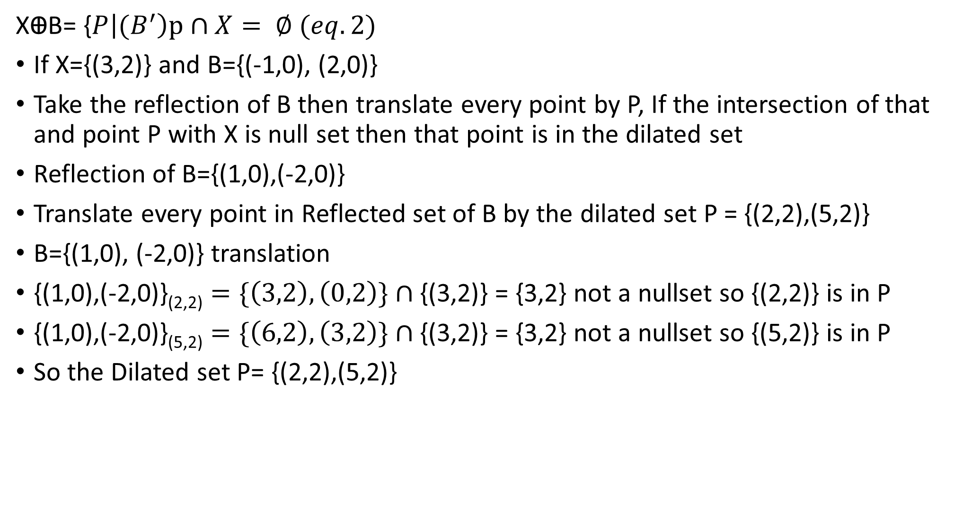
$\text{X}\text{Ꚛ}\text{B}\text{=}$ {$P\left|{(B}^{′}\right)p∩X= ∅ (eq.2)$
If X={(3,2)} and B={(-1,0), (2,0)}
Take the reflection of B then translate every point by P, If the intersection of that and point P with X is null set then that point is in the dilated set
Reflection of B={(1,0),(-2,0)}
Translate every point in Reflected set of B by the dilated set P = {(2,2),(5,2)}
B={(1,0), (-2,0)} translation
{(1,0),(-2,0)}_{(2,2)} $=\{\left(3,2\right),\left(0,2\right)\}∩$ {(3,2)} = {3,2} not a nullset so {(2,2)} is in P
{(1,0),(-2,0)}_{(5,2)} $=\{\left(6,2\right),\left(3,2\right)\}∩$ {(3,2)} = {3,2} not a nullset so {(5,2)} is in P
So the Dilated set P= {(2,2),(5,2)}

